Slide 1
11.0 Linear Feedback Systems
      11.1 Basic Principles of Linear
      Feedback
x(t)
x[n]
e(t)
e[n]
y(t)
y[n]
+
H(s)
H(z)
＋
－
G(s)
G(z)
r(t)
r[n]

Slide 2
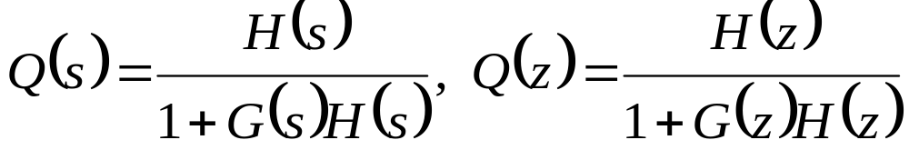
11.0 Linear Feedback Systems
      11.1 Basic Principles of Linear
      Feedback
  H(s), H(z): forward path system function
  G(s), G(z): feedback path system function
  Q(s), Q(z): close-loop system function

Slide 3
  Example 1: telescope positioning system
    See Fig. 11.1, p.817 of text
close-loop system vs. open-loop system
insensitivity to precise knowledge of the open-loop system characteristics
insensitivity to disturbances
tolerance to errors
  Example 2: autopilot system for airplanes

Slide 4
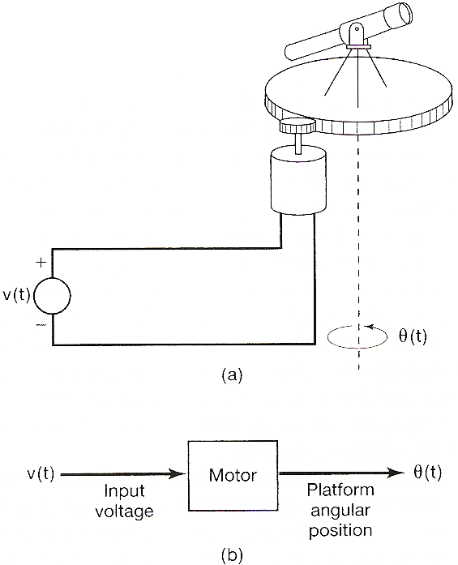
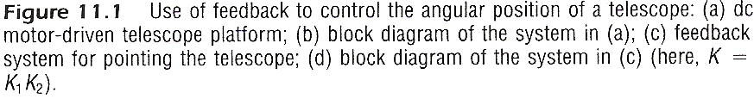

Slide 5
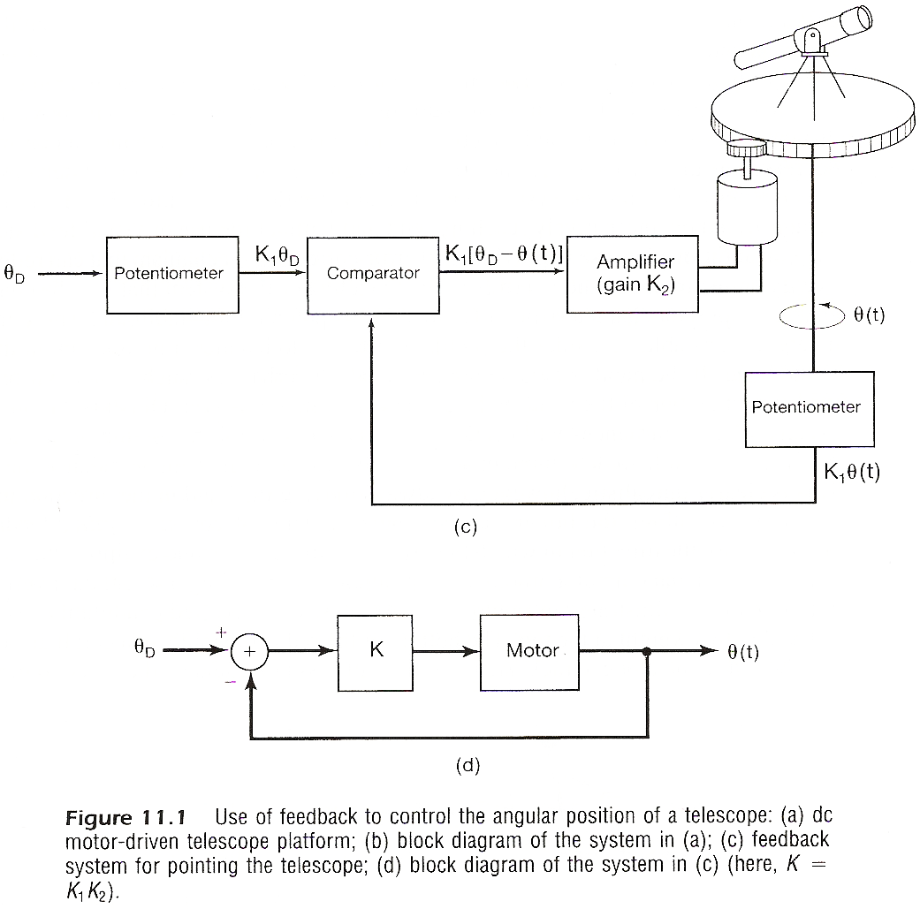

Slide 6
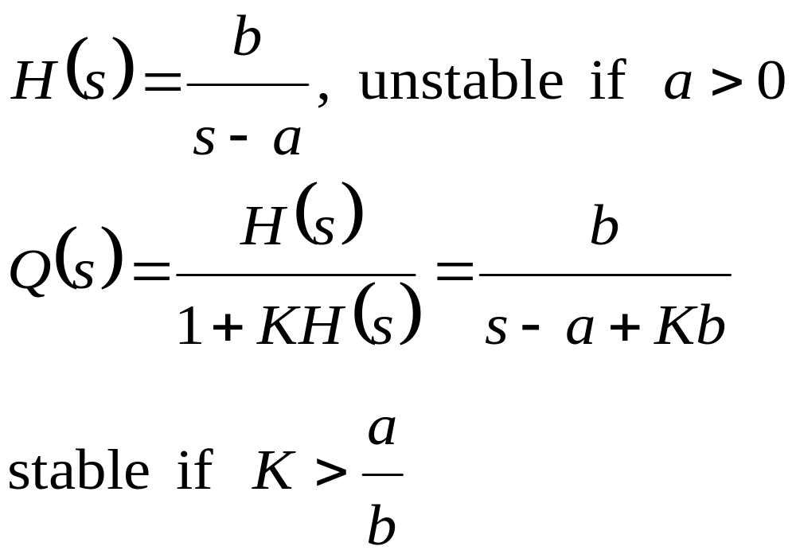
Stablization of Unstable Systems
  Example 3:

Slide 7
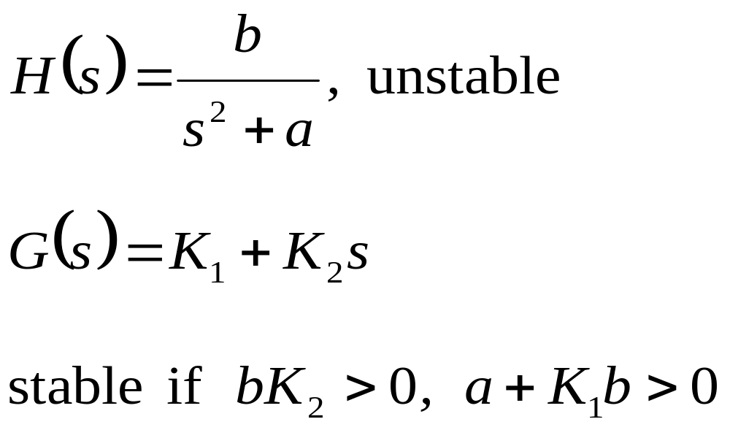
Stablization of Unstable Systems
  Example 4:

Slide 8

Destablization Caused by Feedback
  Example 5: audio feedback
    See Fig. 11.8, p.831 of text

Slide 9
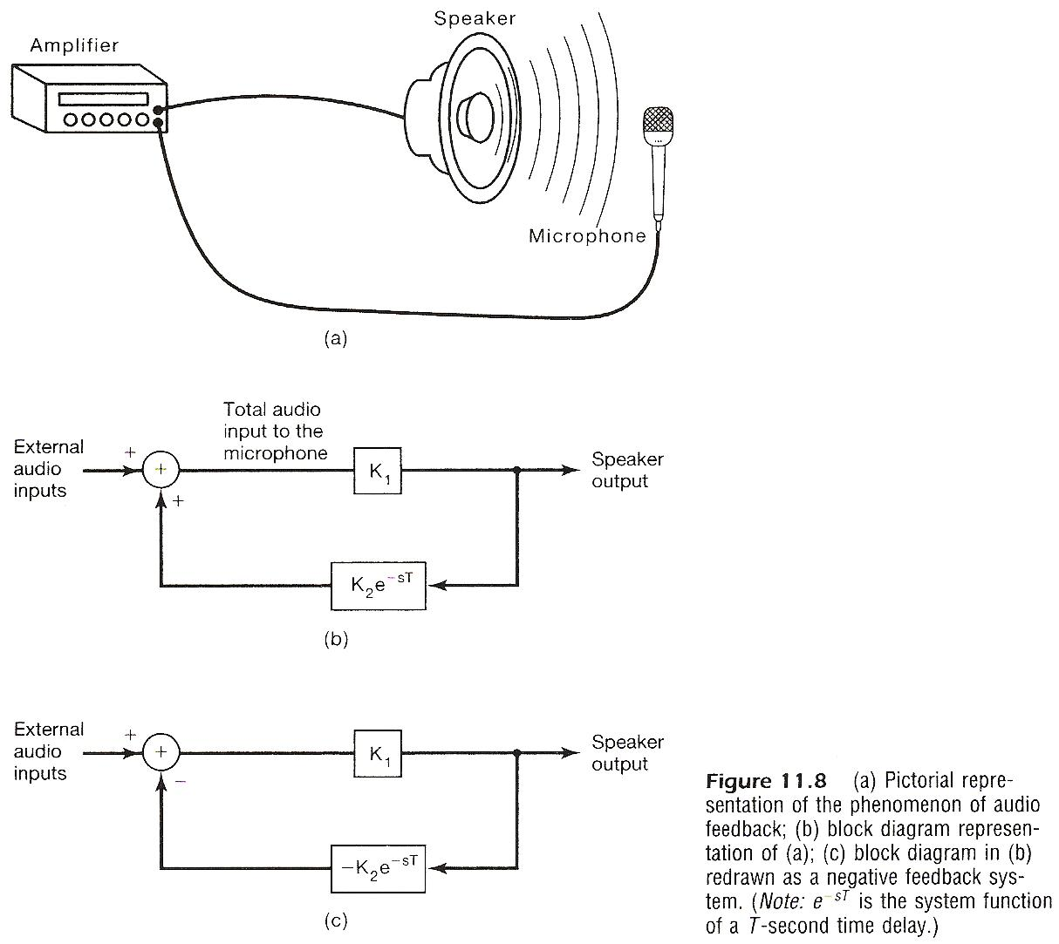

Slide 10
Sampled-Data Feedback System
  discrete-time feedback for continuous-time systems
    See Fig. 11.6, p.827 of text
The Adjustable Gain can be on either arm
    See Fig. 11.10, p.835 of text

Slide 11
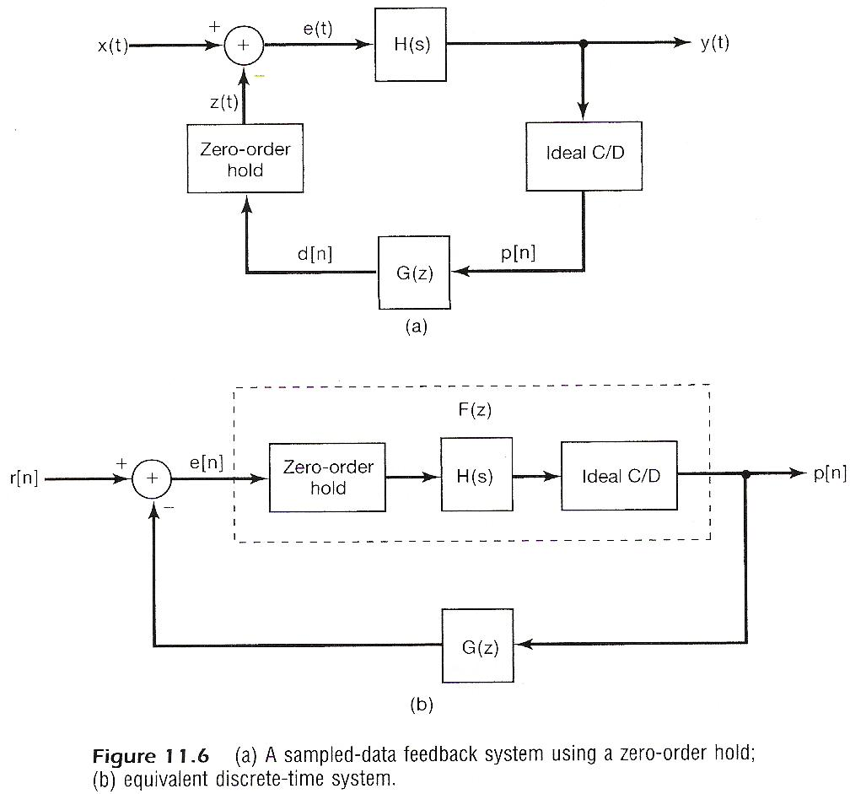

Slide 12
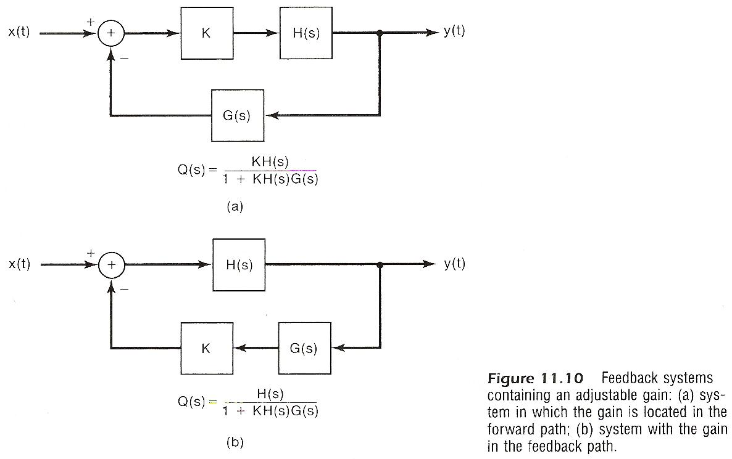

Slide 13
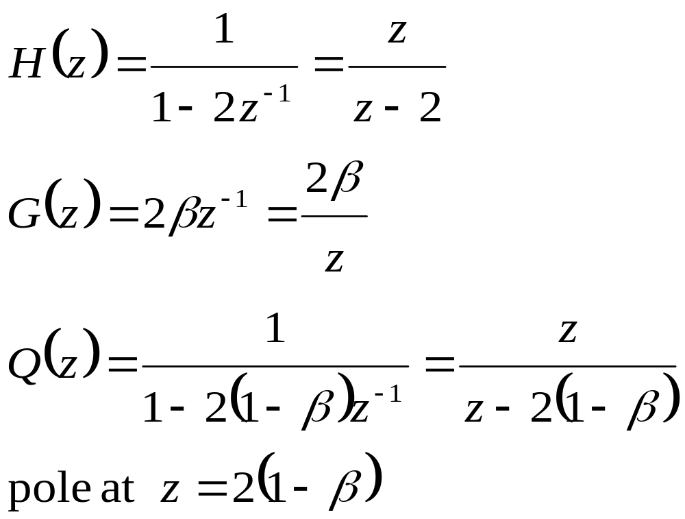
Root-locus Analysis for Feedback Systems
  the locus (path) for the poles of the close-loop system when an adjustable gain is varied
  Example 6:
    See Fig. 11.9, p.834 of text

Slide 14
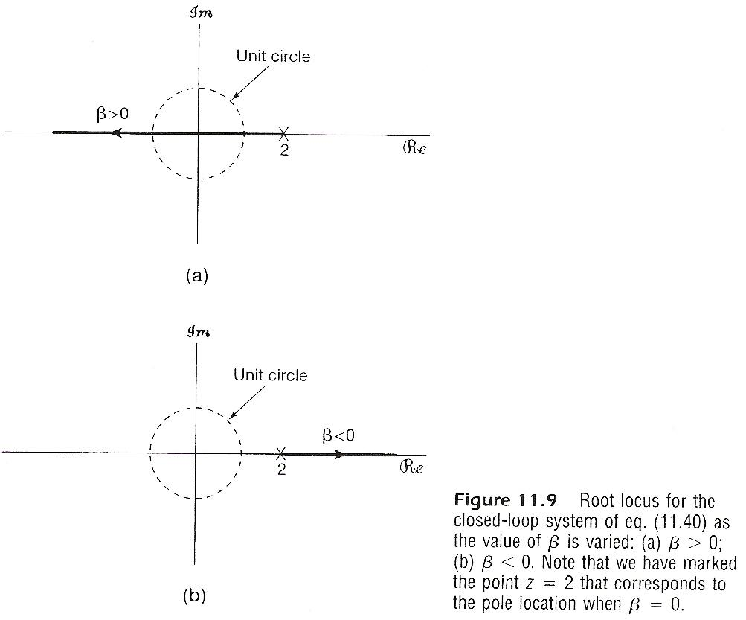

Slide 15
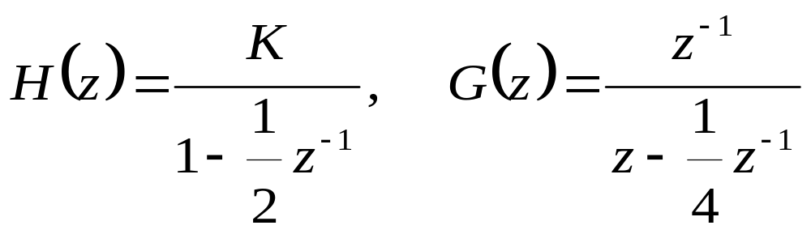
Root-locus Analysis for Feedback Systems
  the locus (path) for the poles of the close-loop system when an adjustable gain is varied
  Example 7:
    See Fig. 11.16, p.846 of text

Slide 16
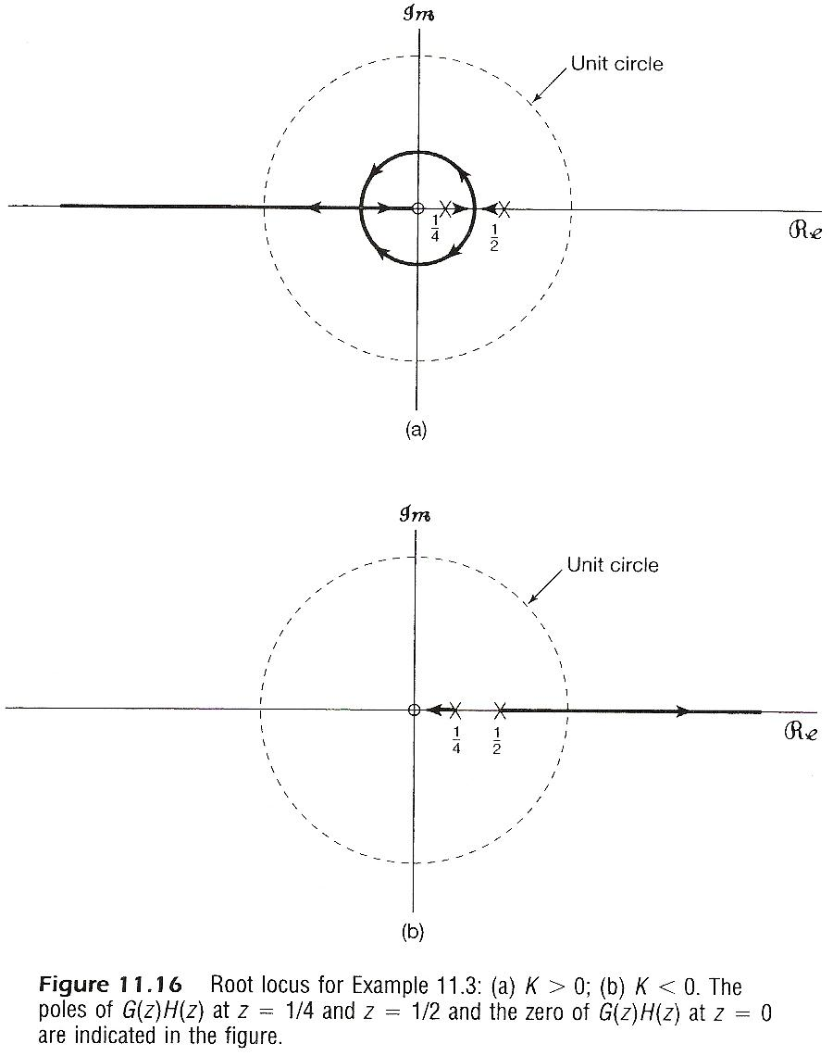

Slide 17
END Of THIS COURSE

